Slide 1
Object-Oriented Programming
WEEK 04 Abeeha Sattar

Slide 2
Garbage Collection
It is a memory management technique
The process of freeing objects no longer referenced by the program

Slide 3
Why Garbage Collection?
This back to PF – For every malloc and calloc, there existed a ??? free
Remember memory leaks?
Free unreferenced objects.
Relieves programmer from manual freeing the memory.

Slide 4
Garbage Collection in Java
Purpose
Find and delete unreachable objects.
Free space as much as possible.
When??
GC is under control of JVM.
One can request but no guarantees.
How??
Discovery of unreachable objects.

Slide 5
Garbage Collection in Java
Ways for making objects eligible for collection
Nulling a reference
Reassigning a reference variable
Using anonymous objects
Forcing garbage collection
Methods available to perform GC
Only requests and no demands
Using Runtime class
Using static methods like System.gc()

Slide 6
The garbage Collection Algorithm
The garbage collector checks to see if there are any objects in the heap that are no longer being used by the application.
If such objects exist, then the memory used by these objects can be reclaimed.
If no more memory is available for the heap, then the new operator throws an OutOfMemoryException.

Slide 7
Finalization
By using finalization, a resource representing a file or network connection is able to clean itself up properly when the garbage collector decides to free the resource's memory.
When the garbage collector detects that an object is garbage, the garbage collector calls the object's Finalize method (if it exists) and then the object's memory is reclaimed.

Slide 8
Finalization
You have no control over when the finalize() method will execute. The object may hold on to resources until the next time the garbage collector runs.
The finalize() method is invoked each time before the object is garbage collected. This method can be used to perform cleanup processing. This method is defined in Object class as:
protected void finalize(){}

Slide 9
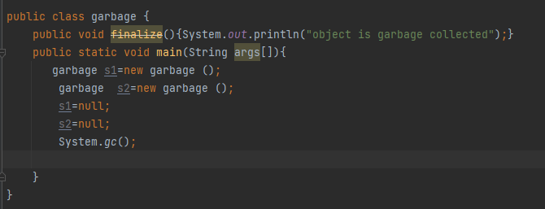

Finalization – By nulling a reference

Slide 10
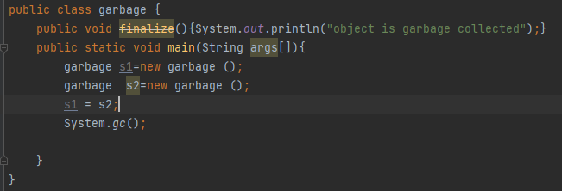
Finalization – By Reassigning References

Slide 11
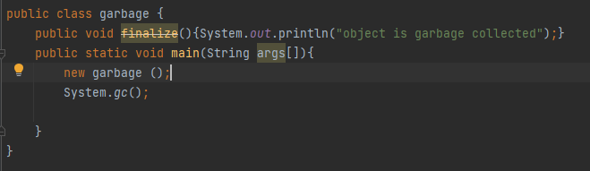
Finalization – By Using Anonymous Objects

Slide 12
Static – The Keyword
The static keyword is used when a member variable of a class has to be shared between all the instances of the class.
All static variables and methods belong to the class and not to any instance of the class

Slide 13
Static – WHEN and HOW you can use them?
When a class is loaded by the virtual machine all the static variables and methods are available for use.
Hence we don’t need to create any instance of the class for using the static variables or methods.
Variables which don’t have static keyword in the definition are implicitly non static.

Slide 14
A Class with Static Members
Class staticDemo{
public static int a = 100; // All instances of staticDemo have this variable as // a common variable
public int b =2 ;
public static showA(){
System.out.println(“A is” +a);
}
}

Slide 15
Using the static variables from Main
Class execClass{
public static void main(String args[]){
staticDemo.a = 35; // when we use the class name, the class is loaded, //direct access to a without any instance
staticDemo.b=22; // ERROR this is not valid for non static variable
staticDemo demo = new staticDemo();
demo.b = 200; // valid to set a value for a non static variable after //creating an instance.
staticDemo.showA(); //prints 35
}
}

Slide 16
Static and Non-static
We can access static variables without creating an instance of the class
As they are already available at class loading time, we can use them in any of our non static methods.
We cannot use non static methods and variables without creating an instance of the class as they are bound to the instance of the class.
They are initialized by the constructor when we create the object using new operator.

Slide 17
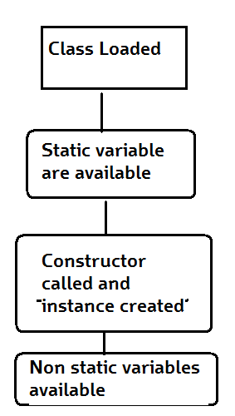
How it Works
Basic Steps of how objects are created
Class is loaded by JVM
Static variable and methods are loaded and initialized and available for use
Constructor is called to instantiate the non static variables
Non static variables and methods are now available
As all the non static variable are available only after the constructor is called, there is a restriction on using non static variable in static methods.

Slide 18
Static Variables, Constants, and Methods
Static variables are shared by all the instances of the class.
Static methods are not tied to a specific object. Because of this, a static method cannot access instance members of the class
Static constants are final variables shared by all the instances of the class.
A non-static (or instance) variable is connected to a specific instance

Slide 19
Static Variables, Constants, and Methods
Static variables store values for the variables in a common memory location. Because of this common location, if one object changes the value of a static variable, all objects of the same class are affected.
Java supports static methods as well as static variables. Static methods can be called without creating an instance of the class.

Slide 20
Example of a Constant (and Static) variable
To declare static variables, constants, and methods, use the static modifier. For example, the constant PI in the Math class is defined as:
final static double PI=3.14159265358979323846

Slide 21
Task:
Create a Circle class with some properties like radius, diameter, circumference, area
Create two functions to calculate and assign circumference and area values to the respective variables.
Modify the Circle class by adding a static variable numberOfObjects to count the number of circle objects created. When the first object of this class is created, numberOfObjects is 1. When the second object is created, numberOfObjects becomes 2.

Slide 22
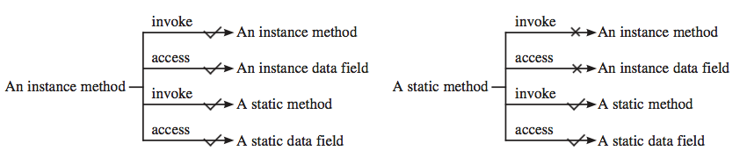
Static and Instance Methods
An instance method can invoke an instance or static method and access an instance or static data field. A static method can invoke a static method and access a static data field. However, a static method cannot invoke an instance method or access an instance data field, since static methods and static data fields don’t belong to a particular object.

Slide 23
Final - The Keyword
In Java, we can use final keyword with variables, methods, and classes.
When the final keyword is used with a variable of primitive data types such as int, float, etc), the value of the variable cannot be changed.

Slide 26
Fin.
: )

